Slide 1
Clearwater State University
Students’ Early Attrition Modelling for Clearwater State University
PROJECT DONE BY
HEMANG H DAGHA
ID: jig20745

Slide 2
IMPORTANT FEATURES
STUDENT CAME BACK TO FIRST SEMESTER IN 2ND YEAR
STUDENT AGE
STUDENT GENDER
STUDENT BACKGROUND
INTERNATIONAL STATUS
HOUSING STATUS
STUDENT MAJOR
ENTRANCE SCORE
ENTRANCE SCORE(CONTINUE)
HIGH SCHOOL gpa
FATHER EDUCATION
MOTHER EDUCATION
STUDENT FINACIAL STATUS VARIABLE
MODELVALIDATION
KEY DRIVERS OF EARLY ATTRITION
RECOMMEND INTERVENTION

Slide 3
Problem statement
IDENTIFY KEY DRIVERS OF early STUDENT ATTRITION
BULID A PREDICTIVE MODEL TO IDENTIFY STUDENT WITH HIGHER EARLY ATTRITION RISK
RECOMMEND APPROPRIATE INTERVENTION BASED ON THE ANALYSIS

Slide 4
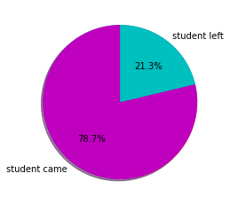
Student came back to First semester in 2nd year
Out of 3400 students 723 student did not show up in second year
The percentage of student leaving without completing their course is very high
As we move forward we get to know which of the attributes affecting the attrition rate

Slide 5
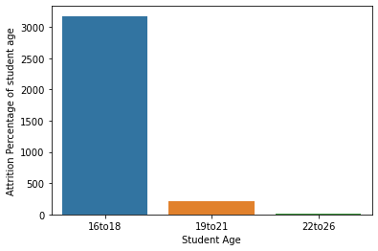
STUDENT AGE
99% of the student are young.
They lies between age 16 to 18 years
And the attrition rate is high for student in the higher age range

Slide 6
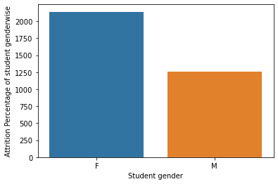
STUDENT GENDER
Out of 3400, 1260 students are male and 2140 are female
It’s good to see that more female student are educating themselves
Female student are more in number and their attrition rate is also slighty more than the male students

Slide 7
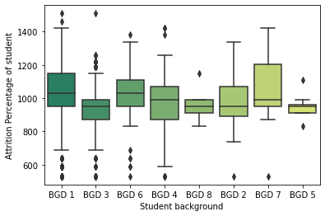
STUDENT BACKGROUND
Most of the students are from background 1 and 3
The students are very less in number for the background 5 and 8
The attrition rate are also high for background 5 and 8

Slide 8
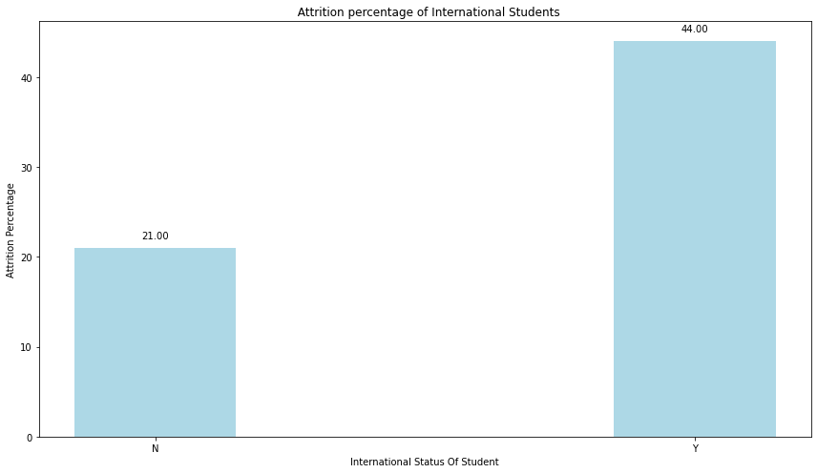
INTERNATIONAL STATUS
The count of international student is very low
Perhaps University should act seriously to attract international student
There attrition rate is very high

Slide 9
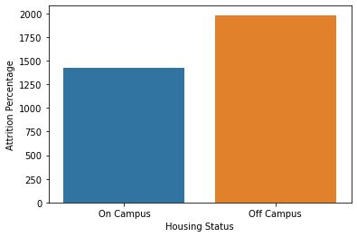
HOUSING STATUS
1420 number of Student are living inside the campus and 1980 are living outside the campus
The number of student living inside the campus is lower.
Their attrition rates seem to be slightly more than the students living off campus.

Slide 10
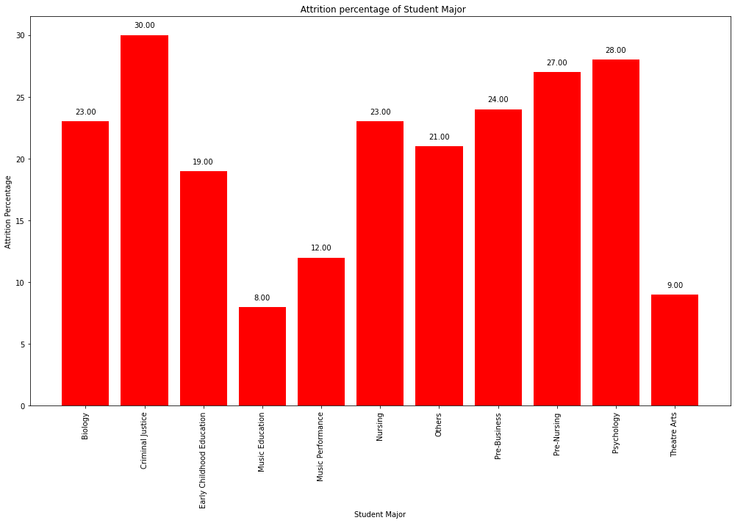
STUDENT MAJOR
Total Major course in university 54
This shows the diversity of the university
The left hand side table shows the top 11 most opted major course by student

Slide 11
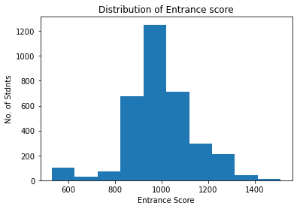
ENTRANCE SCORE
We have 130 very poor performing student
73 student are below average
2641 student performs average in entrance exam
556 student have high score in entrance exam. Out of that 48 student are having very high score.

Slide 12
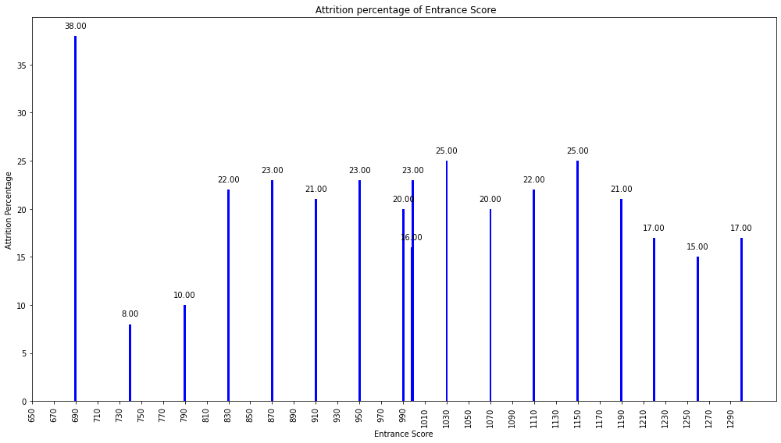
ENTRANCE SCORE (CONTINUE)
We can see that the most of the student are in the medium range of entrance test marks
The attrition rate ranges from 15% to 25% for most of the scores.

Slide 13
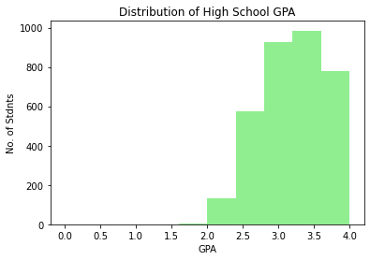
HIGH SCHOOL GPA
There are student who have poor GPA but performs good in entrance exam.
On the other hand there are student who have very good GPA but poor performance in entrance exam

Slide 14
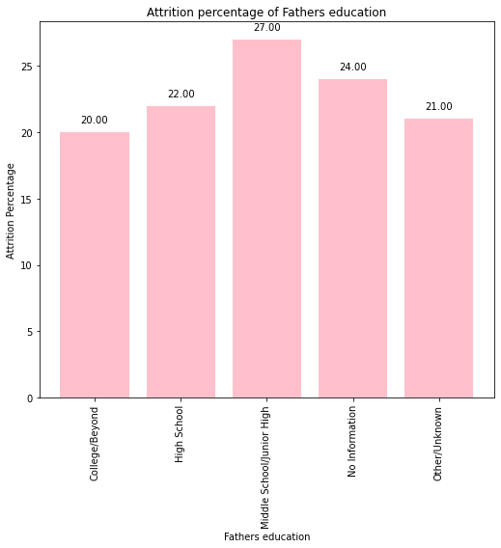
FATHER EDUCATION
Most of the student’s father have education above high school level.
The attrition rate for students of father whose education is below high school level are more than the other students.

Slide 15
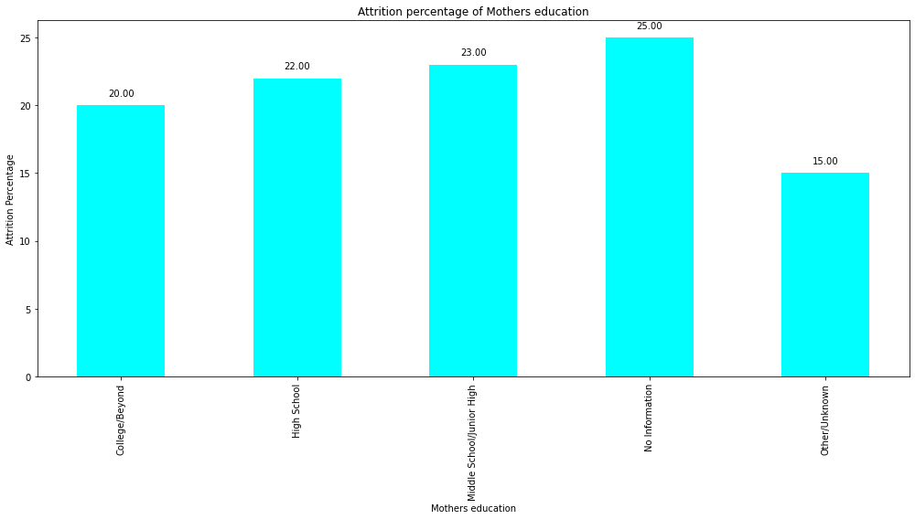
MOTHER EDUCATION
Most of the student’s mother have education above the high school level.
The attrition rate for the student of mothers whose education is below high school level are more than the other students.

Slide 16
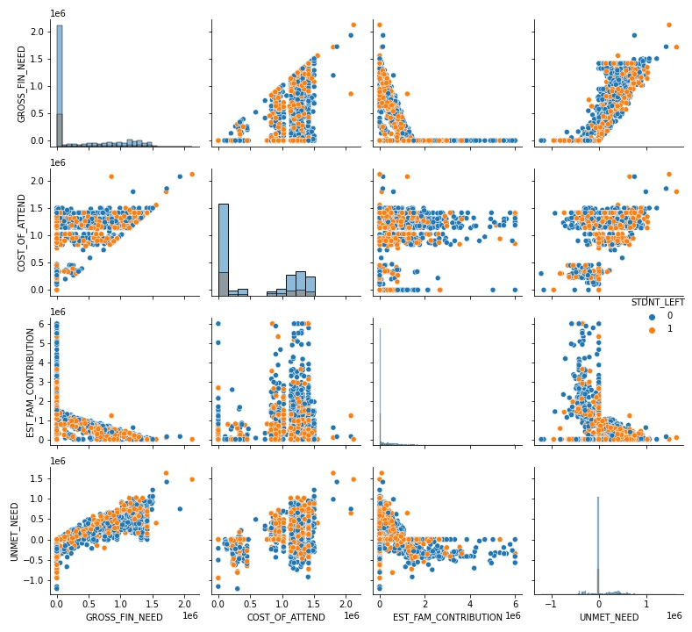
STUDENT FINANCIAL STATUS VARIABLES

Slide 17
STUDENT FINANCIAL STATUS VARIABLES
AS THE DROSS FNANCIAL NEED INCREASE THE UNMET NEED OF THE STUDENT INCREASES.THERE IS NO CLEAR DIFFERENCE SEEN BETWEEN STUDENTS WHO ARE ATTRITE AND THOSE WHO DO NOT
AS THE COURSE FEES INCREASE OBVIOUSLY THE GROSS FINANCIAL NEED INCREASES.THERE IS NO CLEAR DIFFERENCE SEEN BETWEEN STUDENT WHO ARE ATTRITE AND WHO DO NOT
WITH INCREASE IN THE COURSE FEES THE ESTIMATED FAMILY CONTRIBUTION IS LOWER SO THAT THE STUDENT WHICH ARE ATTRITE THAN THE STUDENT WHICH ARE CONTINUE THE COURSE ARE HIGHER FEES AND LOW FAMILY CONTRIBUTION ARE REASON FOR ATTRITION
GROSS FINANCIAL NEED INCREASES, THE ESTIMATED FAMILY CONTRIBUTION DECREASES.SO THERE ARE NO CLEAR DIFFERENCE SEEN BETWEEN STUDENT WHO ATTRITE AND WHO DO NOT
COURSE FEES FOR THE MOST OF THE COURSE LIE AROUND 1000000

Slide 18
MODEL BUILDING
For this classification problem, we are using gradient boosting classifier to predict the attrition rate.
The dummy variables for the categorical variables are created.
The dataset is split into training and test datasets in the ratio 80:20
A grid search is conducted to find the best number of estimators to get the best accuracy score. The grid search returned a value of n estimators=210.
Therefore the final model is built with 210 estimators. The accuracy score obtained is 0.8382352941176471

Slide 19
Model validation
To validate the model, we use confusion matrix and ROC curve
CONFUSION MATRIX
 | 0 | 1
0 | 524 | 16
1 | 94 | 46

Slide 20
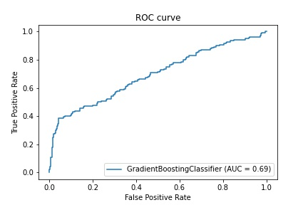
MODEL VALIDATION
The area under curve in ROC for the model is 0.7004100529100528.THE MODEL WHICH PERFOM AS PER EXPECTED

Slide 21
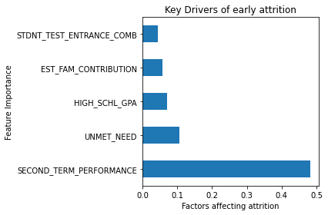
KEY DRIVERS OF EARLY ATTRITION
The feature importance for each variable is computed the variable with the 5 most important are the key drivers of early attrition

Slide 22
Recommend interventions
From the model results it is seen that the performance of the students right from the high school to the second term in the university, highly affect the student attrition. The teachers and parents should encourage the students to perform well and provide the required assistance to the students, right from school, so that they do not leave the university without completing their course.
Next to the Student performance, the financial status (unmet need and estimated family contribution) of the students determine their possibility of attrition. The University might identify student s performing well and provide them with financial assistance in the form of scholarships or sponsors, in collaboration with the government or NGO's if needed.

Slide 23
Recommend interventions(CONTINUE)
Hire students with the best Highschool grade performance. Need to setup a GPA limit where students who are scored better are supposed to be admitted to college
Students who have higher Unmet need in financial terms tend to leave. Scholarships needs to be provided or the Financial burden on student needs to be less in order for them to perform academically well.
Students who are less likely to have attempt hours needs to be noted and push them for getting more attempt hours. The less attempt hours is key contributor in student attrition rate
2nd semester performance of students is indicating which students with low grades are highly tend to attrition. Those students needs to be grouped and categorised. They might be given with some additional focus to make them perform better and to be dealt separately.

Slide 24
THANK YOU

